Slide 1









FOOD DELIVERY WEBSITE

Slide 2


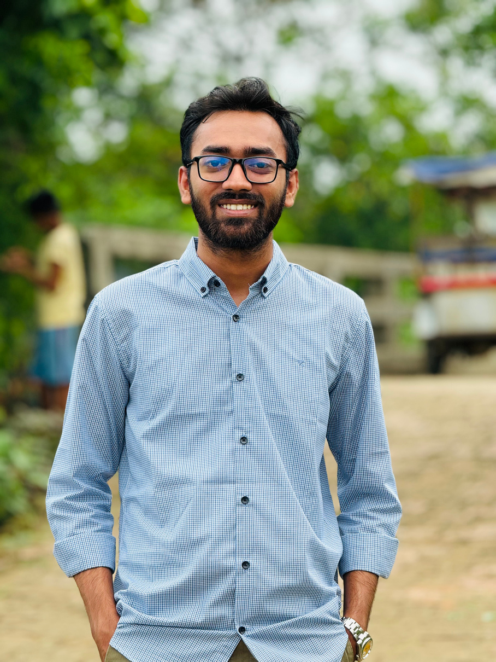


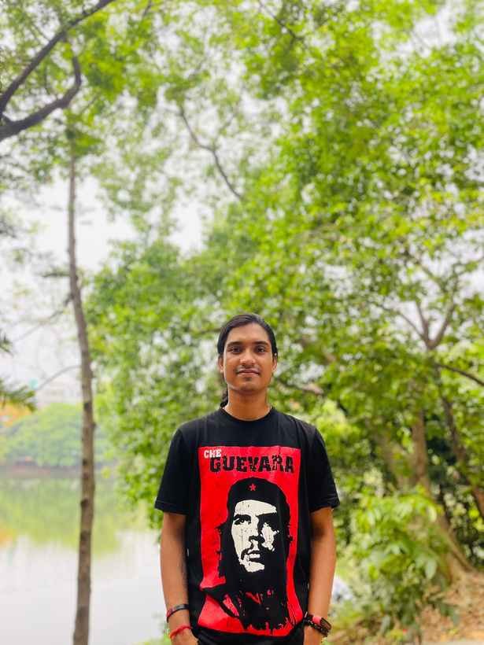

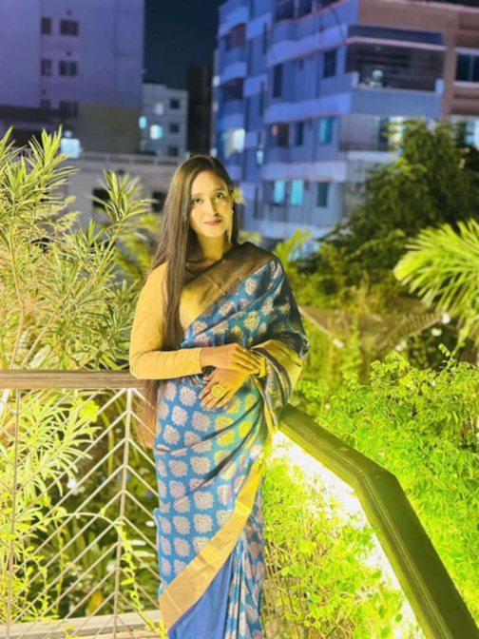
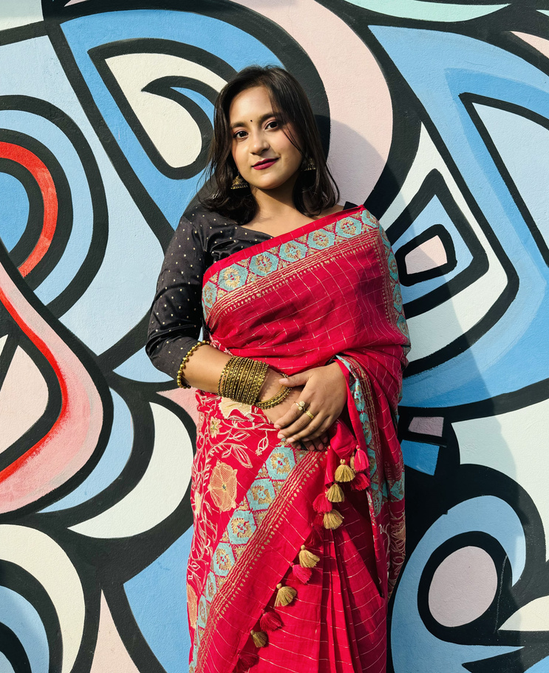
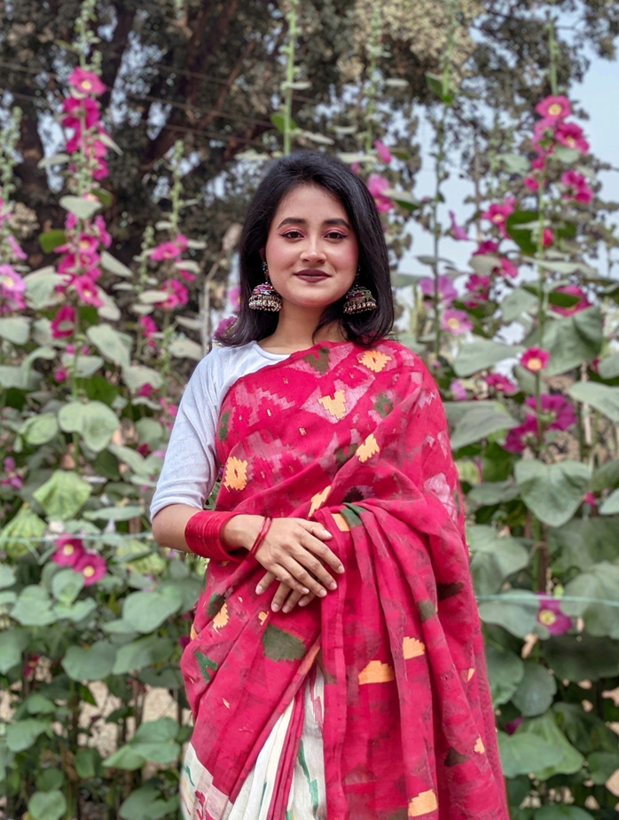



Group Members
RAHAT
DIPTA
ESA
INSANA
NABILA

Slide 3









Project Overview
This food delivery website operates its kitchen, preparing and delivering meals directly to customers. By managing both cooking and delivery in-house, it ensures fresh, high-quality food and reliable service, providing customers with a smooth and satisfying experience.

Slide 4
Objectives
Ensure High Food Quality
Efficient Delivery
Offer a Varied Menu
Build a Strong Brand
Listen to Customers
Encourage Customer Loyalty

Slide 5
Current Progress
Milestones are key points in a project that help track progress and ensure things are on track. The milestones we’ve achieved -
Project Start & Approval
Planning Completed
Gathered Requirements
Design Phase

Slide 6
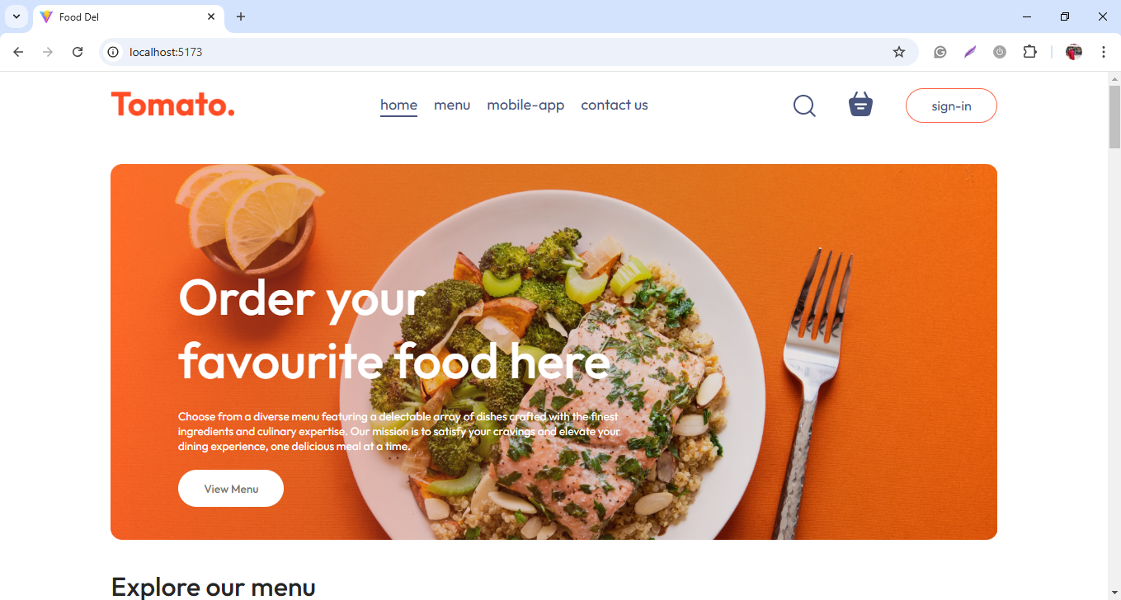
Homepage

Slide 7
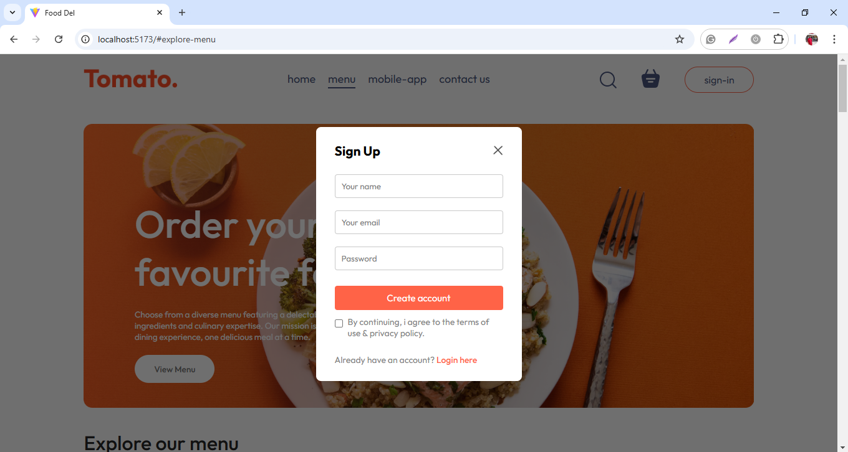
Registration

Slide 8
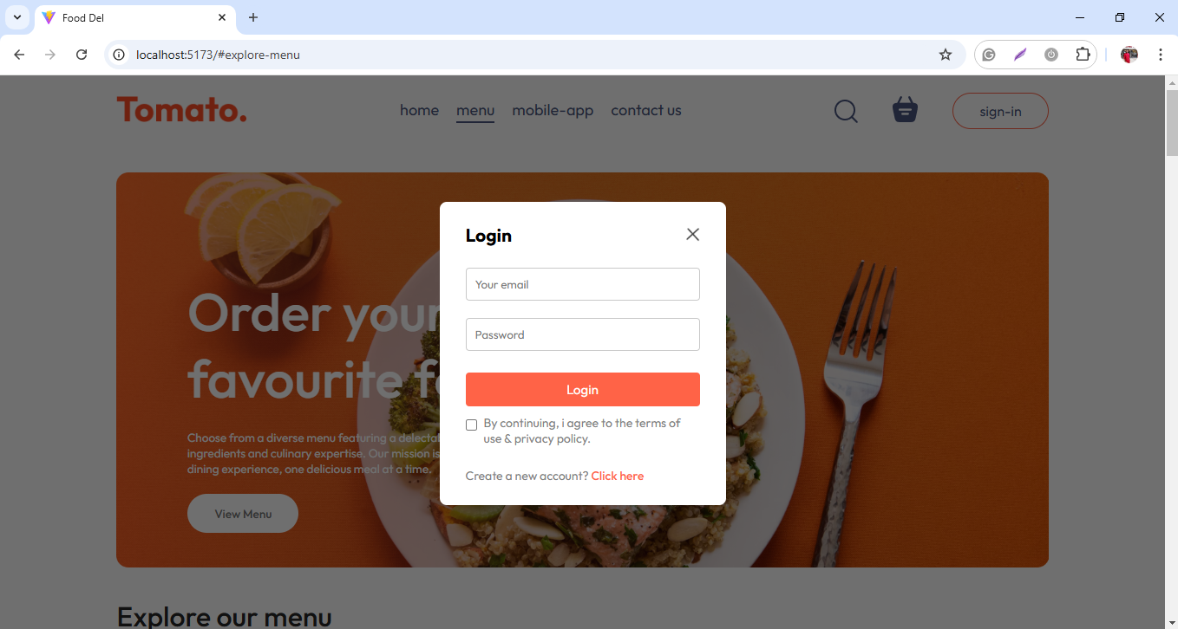
Login

Slide 9
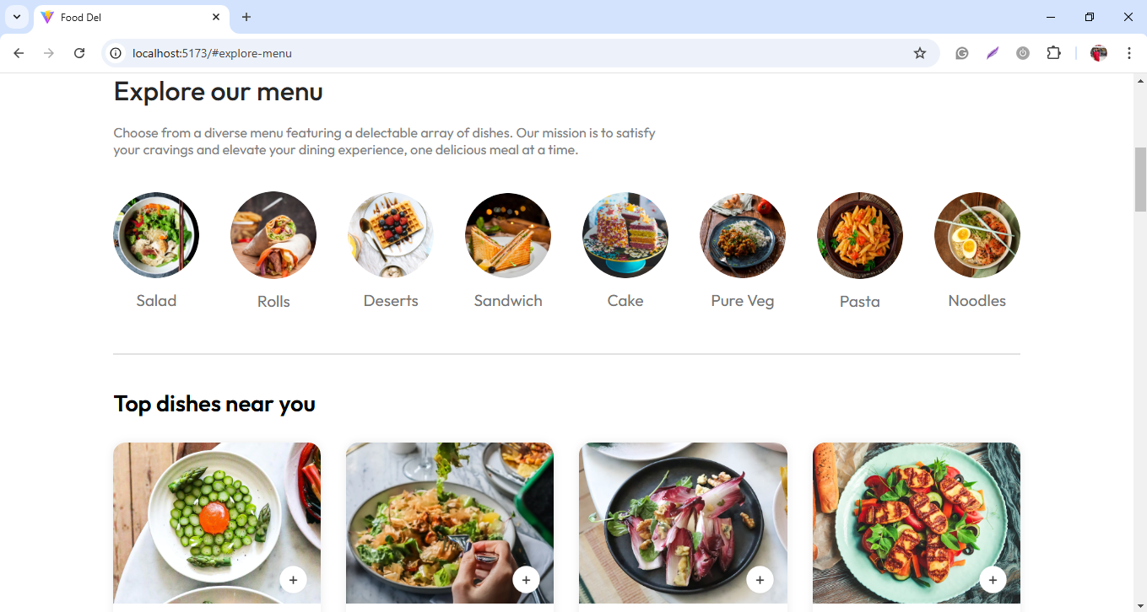
Menu

Slide 10
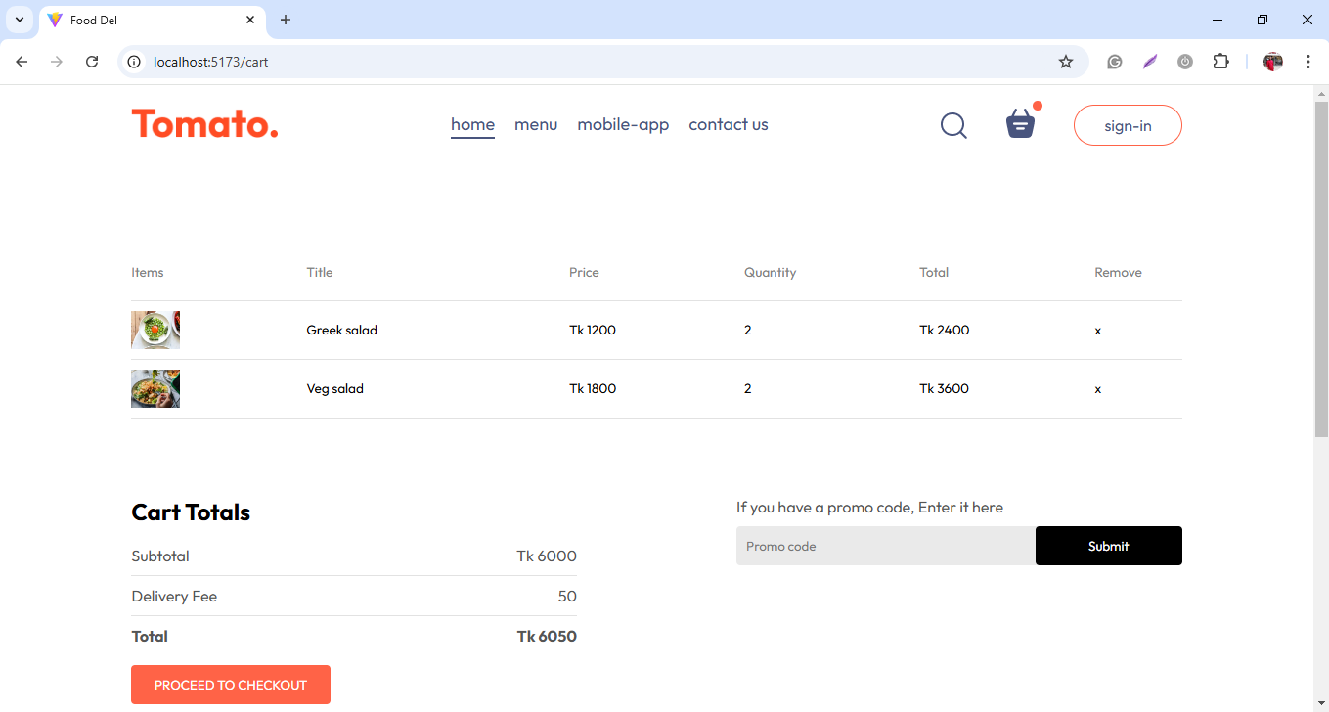
Cart Page

Slide 11
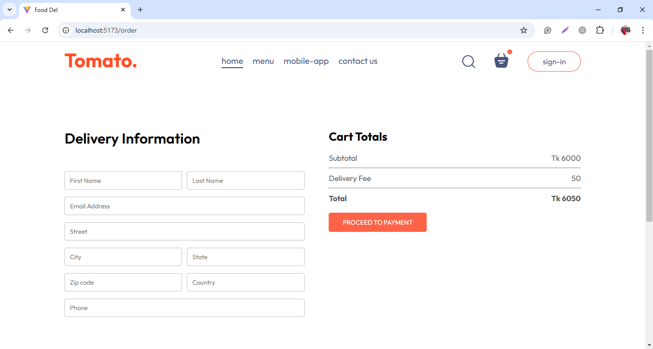
Order Page

Slide 12
Challenges Faced
Defining Clear Requirements
Technology Integration
User Experience Design

Slide 13
Next Steps & Timeline
Next Steps
Week 1
Week 2
Week 3
Week 4
Week 5
Week 6
Week 7
Week 8
Testing
Pilot or Test Launch
Full Launch
Project Review and Closure
Post-Launch Support

Slide 14
Tools
Project Management Tools: Trello
Design and Prototyping Tools: Figma
Version Control Systems: Git(with platforms like GitHub)
Development Frameworks: React, Node.js
Database Management Systems: MongoDB

Slide 15
Techniques
Agile Methodology: Using short development cycles for flexibility and quick feedback-driven improvements.
User-Centered Design: Prioritizing user needs to enhance the overall experience.
Responsive Design: Ensuring the website adapts smoothly to all devices and screen sizes.
CI/CD: Automating code integration and seamless updates.
Testing & QA: Running multiple tests to ensure functionality and quality.

Slide 16
Technologies
Web Development Languages:
Frontend: HTML, CSS, JavaScript
Backend: Node.js

Slide 17
Team Collaboration
Members | Roles
Md. Rahat Bin Aowlad | Frontend
Insana Rahman | Frontend
Taslima Azgar Esa | Documentation
Dipta Paul | Backend
Nabila Tabassum | Backend

Slide 18




Thank You!

